Slide 1
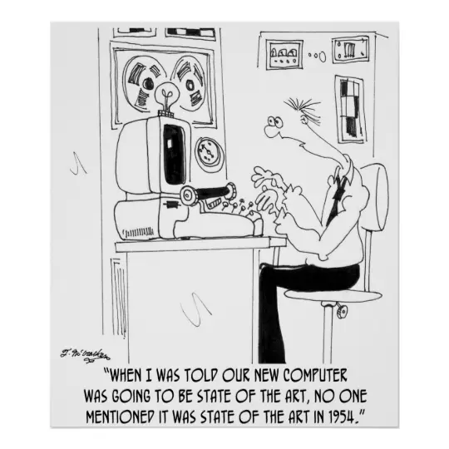

Slide 2
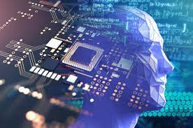
Lecture 4: Intro to Computer Architecture

Slide 3
The Uber Stack
S O F T WA R E
Applications
Middleware
Operating Systems
Computers
Processors | Memories | Display Components | Interconnects
Materials
Physics
H
A
R D W A R E
Notes:
Fed from developments in lowest and highest levels
Even if you don’t remember the past, you are condemned to repeat it…
What is the cycle time?

Slide 4
How We Interact with Computers
Applications
User
Operating System
Hardware

Slide 5
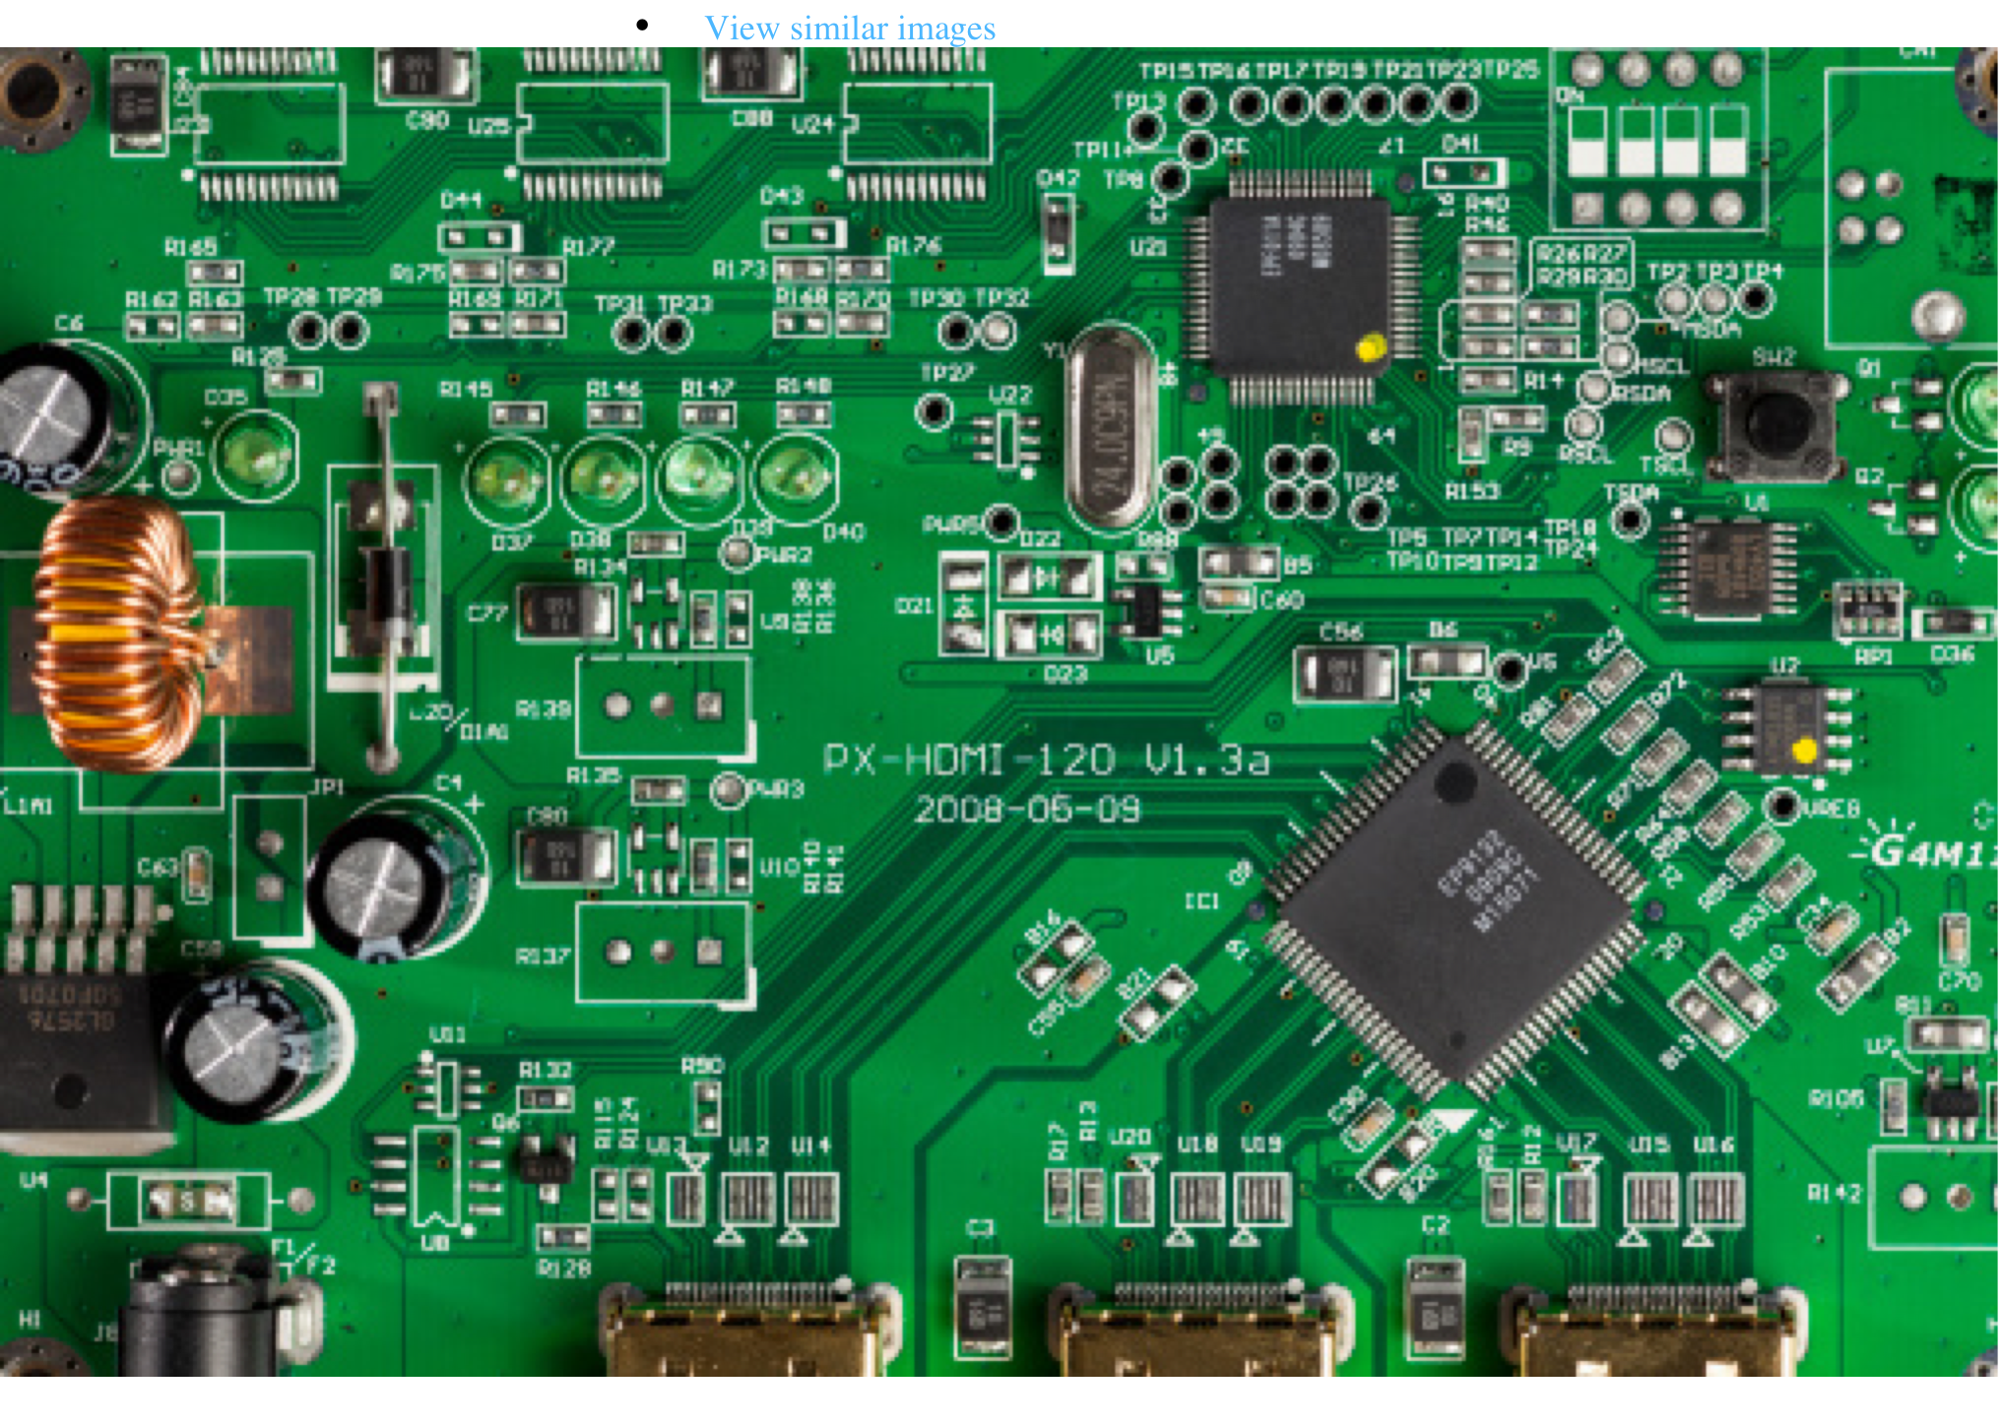
Digital Components

Slide 6
“Digital”
DIGITAL - Digital means discrete.
Digital representation is comprised of a limited number of data points to encode information.
Most of our electronic devices use Digital techniques to work with data and information.
Since we have a limited number of data points to work with, it means that many representations are approximations of the real thing. The more data points, the better the approximation.

Slide 7
Analog vs. Digital
Analog is continuous, Digital is discrete

Slide 8

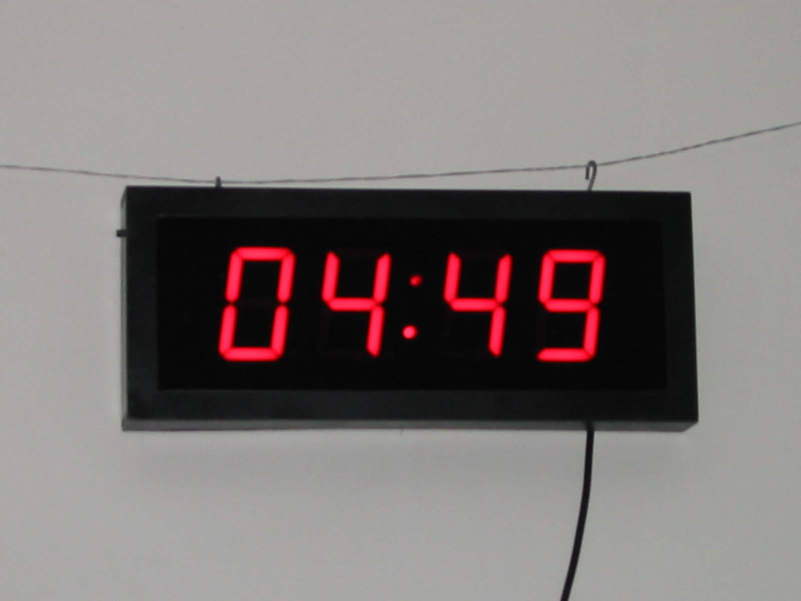
The difference between “analog” and “digital”
ANALOG
DIGITAL

Slide 9
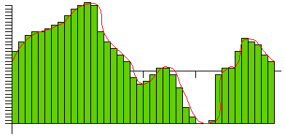
Analog vs Digital
Discrete Digital Sampling of an Analog Event

Slide 10
Bits ( = Binary Digits)
Internally, all data in a digital device is contained in memory locations that are either on or off.
Thus everything in memory can be thought of as being expressed in “bits”, aka “binary digits”
where on = 1 and off = 0
a single “bit” can represent only 2 values,
0 or 1

Slide 11
Binary numbers
Obviously with 1 bit we can only represent two values 0 and 1
With 2 bits we can represent four different values:
00, 01, 10, 11
With 8 bits (otherwise known as a byte) we can represent 256 values
( 0-255)

Slide 12
Nomenclature
A BIT is a single 1 / 0 position
A NIBBLE is 4 BITS
A BYTE is 8 BITS
A WORD is a multiple of BYTES eg: 16 bits, 32 bits, 48 bits, 64bits……….
Common nomenclature today is to define memory storage and data capacity in BYTES

Slide 13
More Nomenclature
As computers have become capable of processing and storing more data, we have coined:
KiloBytes (Thousands)
MegaBytes (Millions)
GigaBytes (Billions)
TeraBytes (Trillions) –Library of Congress 30Tb
PetaByte (1000 Trillion)
ExaByte (Million Trillion)

Slide 14
Base 2 (Binary) vs. Decimal Comparison
10⁵ 10⁴ 10³ 10² 10¹ 10⁰
10^{n} = 100,000 10,000 1000 100 10 1
2⁷ 2⁶ 2⁵ 2⁴ 2³ 2² 2¹ 2⁰
2^{n} = 128 64 32 16 8 4 2 1

Slide 15
Representing Data in the Computer
Internally, everything--data, programs, text, you name it--is represented in bits.
With an array of bits, we can represent any number or, thru assignment, any character so, for example:
0011 0000 = decimal 48 = “H”
(256 combinations, 0 to 255)

Slide 16
How could we represent letters for instance?
For characters we need 26 letters, 10 numbers, special marks, etc. About 127 possibilities including upper and lower case and special control characters
Unicode is an agreed upon code in which every character, numbers, etc. is given a unique 8 bit code (1 byte).
So we need 4 bytes to represent the word “love”

Slide 17
Remember, everything is represented in bits!
2 Bits – 00, 01, 10, 11
3 Bits –
4 Bits-
.
.
8 Bits-
16 Bits-
24 Bits-
4 values
8 values
16 values
256 Values
65,536 Values
16,777,216 Values

Slide 18
Good tutorial on Binary
http://www.swansontec.com/binary.html

Slide 19
What are computers made of?
Primarily Transistors
Invented in 1947, the Transistor is the basic electrical building block for all modern electronics
“the greatest invention of the 20th century”
For Digital applications, transistors are typically packaged in what is known as Integrated Circuits (ICs) aka “CHIPS”
More than 30+ Billion Transistors can be packaged in a single large IC today

Slide 20
Anatomy of a Transistor
Transistors are fabricated using purified silicon (derived from quartz) and tiny amounts of impurities such as selenium or gallium arsenide to create what is called a “semiconductor”
Semiconductors allow us to control the flow of electrical charge (electrons) very precisely.
Billions of semiconductors can be placed on an integrated circuit using a process called photolithography

Slide 21
Transistor Functionality
In various circuits Transistors can be made to:
Amplify or Attenuate electrical signals
Invert electrical signals
Store electrical voltage values
Switch electrical signals off and on
Transistors can be interconnected to create logic circuits commonly known as “GATES”

Slide 22
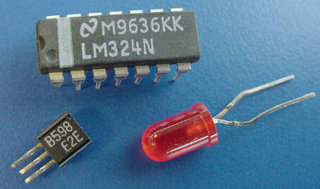
Simple Silicon Semiconductor Devices

Slide 23
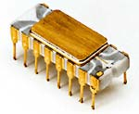
Intel 4004 Processor Chip circa 1971
It could only add and subtract 4 bits at a time.

Slide 24
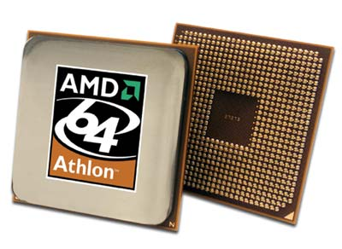
AMD Athlon64 Processor

Slide 25
Use of Logic Gates in Computers
Primary Uses:
Switches and logic circuits that can be switched between 0 and 5 volts. In this way a Switch can signify a “bit” that is a 1 or a 0
Storage of voltage levels equivalent to 0 or 5 volts. In this way a “bits” of memory can be implemented or pixels on an LCD display on a laptop can be created

Slide 26
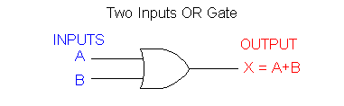
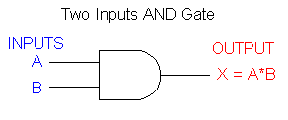
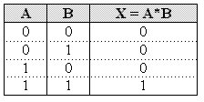
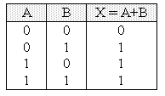
AND and OR Gates

Slide 27
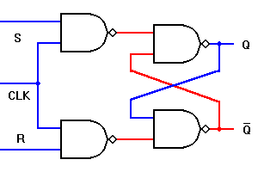
By combining gates we can create useful functions such as a the ability to store a bit of information
The purpose of a latch is to allow a data value to be stored temporarily. So that we can hold it and “use” it for awhile…like a “bit” of memory

Slide 28
The Von Neumann Machine
CPU = Central Processing Unit
Memory
OUTPUT
INPUT

Slide 29
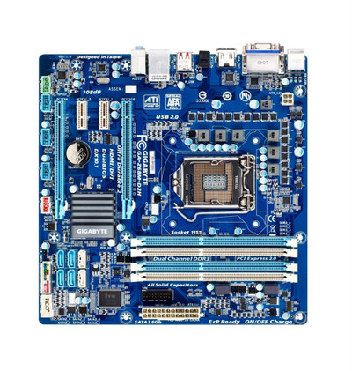
A typical PC CPU board

Slide 30
Fetch, Decode, Execute Cycle
Computer instructions are stored (as bits) in memory. To run a program, each instruction is:
Fetched from memory.
Decoded (the computer figures out what it should do based on the number).
Then the instruction is executed.
The speed at which this cycle occurs is determined
by the system clock

Slide 31
Cycle Times
Generally the faster your computer can get through a fetch-decode-execute cycle, the faster it will perform.
Cycle times are measured in “gigahertz”, a billion cycles per second.
PCs these days reach 3500 Megahertz or 3.5 Gigahertz (3 billion cycles/sec)

Slide 32
Memory
Each memory unit has its own address
Memory units are organized in groups of Bytes (8 bits) or Words (16, 24, 32, 64 or 128 bits)
0 1 2 3 4 …………………………………..16 Billion
0
1
1
1
0
0
0
1

Slide 33
Random Access Memory
The main computer memory is called RAM (Random Access Memory)
It is “random” in that one may access any addressable memory unit independently of any other (and thus in “random” order).
In almost all modern machines the smallest single addressable amount of memory is one byte.
Memory is measured in megabytes or gigabytes or terabytes (millions, billions or trillions)

Slide 34
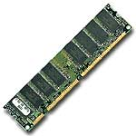
RAM chips on a Circuit board

Slide 35
Dynamic Random Access Memory
RAM allows for both reading and writing in memory. Contrast this with ROM (read-only memory).
Most RAM is volatile, or “dynamic”. When you turn off the power, the contents of RAM is lost.
Sometimes one talks about DRAM which is short for dynamic RAM).

Slide 36
Read Only Memory
Read Only Memory can only be read from
It’s contents cannot be altered or written over easily
This type of memory is used to hold instructions that need to always be there
For example, the initial instructions that are executed when your PC is turned on which instructs the machine to load Windows from the disk drive

Slide 37
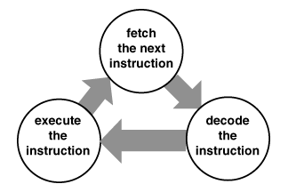
Central Processing Unit
manages the instruction-execution cycle
FETCH – DECODE – EXECUTE
coordinates the activities of other devices

Slide 38
Machine Language
Every computer CPU has its machine language, the set of basic instructions it knows how to execute.
A typical set of instructions might mean, “get the contents of certain a memory locations and put it in the accumulator register and then add them together and store the results in a different memory location”

Slide 39
Machine Instructions
Such an instruction would consist of two numbers:
One would be the address of memory to be accessed.
The other would be the operation code of the instruction - the (somewhat arbitrary) number that refers to a unique and particular type of instruction

Slide 40
Central Processing Unit
manages the instruction-execution cycle
FETCH – DECODE – EXECUTE
coordinates the activities of other devices

Slide 41
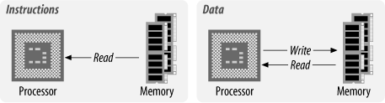

Slide 42
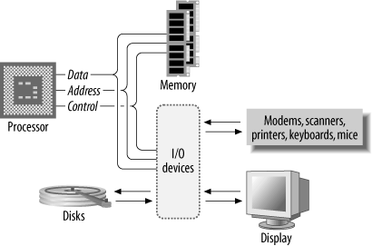

Slide 43
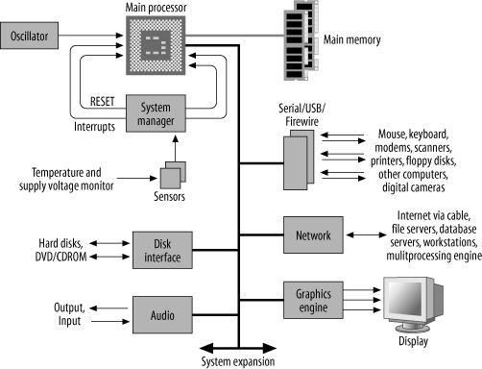

Slide 44
Types of Processor Operations
Data Movement Operations
moving data from memory to the CPU
moving data from memory to memory
input and output
Program Control
starting a program
halting a program
skipping to other instructions
testing data to decide whether to skip over some instructions
Arithmetic and Logical Operations
integer arithmetic
comparing two quantities
shifting, rotating bits in a quantity
testing, comparing, and converting bits

Slide 45
Challenges to Continuation of Moore’s Law
The thickness (in atoms) between the silicon layers in transistors is getting very thin as we attempt to cram more transistors into the same amount of space…so much so that new materials need to be developed
HEAT!! As we put more and more transistors on a chip, the ability to cool it and keep it from burning up is increasingly a problem
Noise - As more transistors are packed ever more tightly together, the noise level of the circuits increases which affects reliability

Slide 46
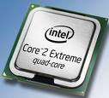
Quad Core Processor
4 CPUs on one chip….. One way to increase performance…
Parallel Processing!

Slide 47
Smaller, Cheaper, Faster!
The Mantra of the Semiconductor Industry

Slide 48
A New Computing Paradigm?
Quantum Computing
Seeks to use the “spin” of atomic particles to implement digital systems
Molecular computing
Using molecules to hold electrical charges instead of using transistors
Both very much in primary research….not here yet

Slide 49
Questions?

